Slide 1
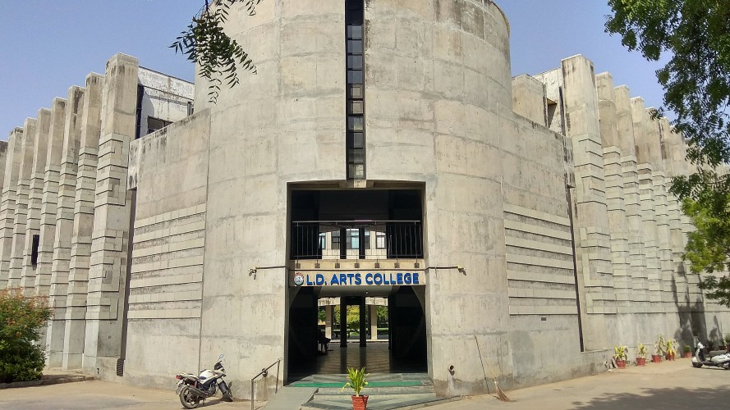

L. D. Arts College
Managed by
Ahmedabad Education Society

Slide 2
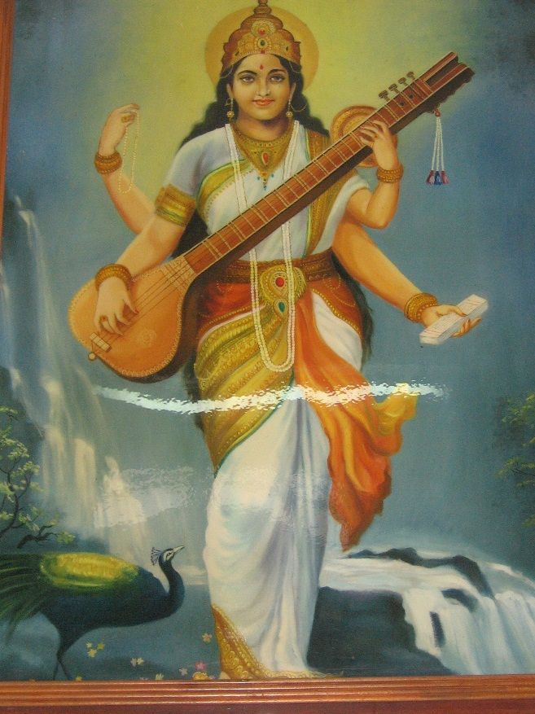
Our Motto
VIDYAYAMRUTAMASHNUTE
Knowledge is the Nectar of Life

Slide 3
Highlights
One of the oldest and prestigious Arts Colleges of Gujarat established in 1937.
Strictly merit based admissions
Well-equipped automated library with 6 computers to access e-resources.
Wi-Fi enabled Internet Connectivity in the campus.
An active Placement Cell
The only Arts Institute under Gujarat University imparting education in both the mediums, English and Gujarati.
Hostel facilities for girls (intake – 62)) along with the mess facilities.
Safe and secure campus.
Spiritual upliftment through daily morning prayers.
Very high success rate in the University examinations.
Vibrant NSS, NCC, Cultural and Sports units.
An active CWDC ( Collegiate Women’s Development Committee).
The only Institute affiliated with Gujarat University which admits foreign students.
One of the biggest study centres of IGNOU (Indira Gandhi National Open University).

Slide 4
Core Courses Offered (Existing)
Faculty | Department | UG | PG | Research (Ph.D.)
Arts | English | √ | √
 | Gujarati | √
 | Hindi | √
 | Sanskrit | √
 | Economics | √ | √
 | Psychology | √ | √ | √
 | Political Science | √
 | Sociology | √ |  | √
 | History | √
 | Geography | √
Statistics and Computer offered as an Elective subjects at UG Level.

Slide 5
Staff Provision and Positions (Data as per 2023-24 year)
Teaching Staff
Teaching Staff
Sanctioned Positions | Filled by Govt. | Filled by AES | With Ph.D. | Ongoing Ph.D. | M.Phil.
46 | 31 Faculties | 10 | 22 | 02 | 02
Non – Teaching/Ad-hoc Staff
Non – Teaching/Ad-hoc Staff
Sanctioned Positions | Filled by Govt. | Filled by AES
10 | 1 | 10

Slide 6
Department Wise Faculty Strength
DEPARTMENT | SANCTIONED | FILLED | DEFICIT | PROVIDED BY AES (VISITING)
PSYCHOLOGY | 5 FULL TIME | 4 | 1 | 1
GEOGRAPHY | 3 | 2 | 1 | 1
SOCIOLOGY | 2 FULL TIME+ 1 PART TIME | 1 | 2 (1 FULL TIME+ 1 PART TIME) | 1
POLITICAL SCIENCE | 4 FULL TIME | 4 | 0 | 0
STATISTICS | 1 FULL TIME | 1 | 1 FULL TIME | 0
ENGLISH | 4 | 3 | 1 | 1
ECONOMICS | 5 FULL TIME | 4 | 1 FULL TIME | 1
GUJARATI | 2 FULL TIME+ 1 PART TIME | 2 | 1 PART TIME | 0
HINDI | 2 FULL TIME+1 PART TIME | 2 FULL TIME+1 PART TIME | 0 | 0
SANSKRIT | 3 | 2 | 1 | 1
HISTORY | 2 FULL TIME +1 PART TIME | 2 | 1 PART TIME | 0
COMPUTER SCIENCE | 1 FULL TIME+ 2 PROGRAMMERS | 1 FULL TIME+ 1 PROGRAMMER | 1 PART TIME + 1 PROGRAMMER | 0

Slide 7
Details of Workload for UG (Department wise)
Sr. No. | Name of Dept. | Papers in UG (E + G) | Papers in PG | Total Work Load of Lectures Per Week | Faculties (Regular) | Faculties (Visiting) | Additional Workload
1 | English | 11 | 12 | 56 | 3 | 1 | 08
2 | Hindi | 11 | -- | 36 + 6 (Fou. + Soft.) | 2 + 1(PT) | 0 | --
3 | Gujarati | 11 | -- | 36 | 2 | 0 | --
4 | Sanskrit | 11 | -- | 42+2(Fou. + Soft.) | 2 | 1 | 06
5 | Psychology | 11 | 12 | 66 | 4 | 1 | 10
6 | Economics | 11 | 12 | 72 | 4 | 0 | --
7 | Political Science | 11 | -- | 72 | 4 | 0 | --
8 | History | 11 | -- | 32 + 4 (Fou. + Soft.) | 2 | 0 | --
9 | Geography | 11 | -- | 42 | 2 | 1 | 06
10 | Sociology | 11 | -- | 32 | 1 | 1 | 14
11 | Statistics | 4 | -- | 24 + 2 (Fou.+Soft.) | 1 | 0 | --
12 | Computer | 4 | -- | 24 +18 (Practicals) | 1+1 (Programmers) | 0 | --
13 | Physical Education | -- | -- | --- | 1 | --- | ---

Slide 8
Sanctioned Intake & Admitted Students
ACADEMIC YEAR | SANCTIONED INTAKE | ADMITTED STUDENTS
2023-2024 | 240 EM + 240 GM = 480 | 241 EM + 224 GM = 465

Slide 9
Department Wise Student Strength 2023-24 (FY.BA)
SUBJECT | ENGLISH MEDIUM | GUJARATI MEDIUM | TOTAL
ENGLISH | 117 | 39 | 156
ECONOMICS | 46 | 25 | 71
PSYCHOLOGY | 24 | 42 | 66
GUJARATI | - | 20 | 20
HINDI | 11 | 15 | 26
SANSKRIT | - | 08 | 08
POLITICAL SCIENCE | 43 | 17 | 60
HISTORY | - | 19 | 19
GEOGRAPHY | - | 20 | 20
SOCIOLOGY | - | 19 | 19
STATISTICS | - | - | -
COMPUTER METHODS | - | - | -
TOTAL | 241 | 224 | 465

Slide 10
Proposals for starting Self-financed Online Courses
Certificate Course on Spoken Sanskrit
Purpose: A proposal for starting Online Certificate Courses in Spoken Sanskrit and the Philosophy of the Bhagavad Geeta.
Certificate Course on Counseling Skill
Purpose: To help individuals to improve their personal growth and learn counseling skills, procedures, and how we are helping those people in our society who are facing mental health issues.

Slide 11
Details of Academic Activity Plan (Department wise)
Sr. No. | Name of Dept. | Academic Activity Plan
1 | English | State Level Workshop on February 1, 2024, Research Approaches in Humanities: Unveiling methodological diversity
2 | Hindi | Hindi Diwas, Book Review and discussion of various works awarded By the Hindi Sahitya Academy Tulsi Jayanti , Introduction and Exposure Given to Students about various Works of Tulsidas
3 | Sanskrit | Subject-Essence of Geeta, 30 Hours, 164 Participants, Course Content- 18 Adhyay of Gyan, Karm, Bhakti Yog,
4 | Psychology | Visit to National Forensic Science University, Gandhinagar Visit to Gov. Mental Health Hospital Ahmedabad
5 | Economics | Study Visit- 108-EMRI Green Health Service-Ahmedabad, Students Participation- 55 Heritage Walk, Old Ahmedabad City, Students Participation- 55 Environment Education Tour - Bakor-Mahisagar District, Students Participation- 58 Education Visit Vibrant Gujarat(2023-24)-Gandhinagar, Students Participation- 30 Education Visit, Bombay Stock Market-Ahmedabad, Students Participation- 25 Vipassana Introduction Program- L.D.Arts College, Students Participation- 160
6 | Political Science | Guest Lecture on “Centre-State Relations in India” by Dr. Hitesh Patel, Associate Professor at The Department of Political Science, Gujarat University in which more than 200 students participated. A Political Science Quiz was organized in which more than 90 Students of both the mediums participated.
7 | History | Visit to Sardar Vallabhabhai Patel National Memorial, Ahmedabad. Visit to L. D. Indology Museum, Ahmedabad.
8 | Geography | Study Tour- Narmada Dam Site
9 | Statistics | Guest Lecture- Exploring Diverse Statistical Methods in Social Sciences Research
10 | Gujarati | Guest Lecture on “ગુજરાતી વિષયની જાહેર પરીક્ષાઓમાં ઉપયોગીતા” Guest Lecture on “અર્વાચીન કવિતા” An Expert Lecture on “Translation Theories and Practices”. Celebration of “માતૃભાષા ગૌરવદિન”
11 | Computer | A Workshop for Faculty Members on “Preparing Dynamic Presentation”. Expert Lecture on Artificial Intelligence.
12 | Sociology | A Study Tour at Social Institute. Guest Lecture on Social Issues. Study Tour.

Slide 12
Various Co-curricular Activities
  The College promotes the participation of students in various extension activities through :
    NSS
    NCC
    Sports
    Cultural activities
  Other Activities :
    Alumni
    CWDC
    Placement cell
    Geeta Slok Gaan and Elocution Competition
    Mahadev Desai Elocution Competition
    Annual Function and Prize Distribution

Slide 13
Details of Co-curricular Activity Plan
Sr. No. | Activity | Co-curricular Activity Plan
1 | NSS | July-23 Orientation Program for New Students. July-23 Tree Plantation Drive. Aug-23 Celebration of Independence Day. Aug-23 Visit to Old age House and Slum Areas. Aug-23 Celebration of Rakshabandhan. Sept-23 Teacher’s Day Celebration. Sept-23 Seminar on Personality Development. Oct-23 Traffic and HIV/AIDS and Thalassemia Awareness Program. Oct-23 Gram Janjagruti Camp. Dec-23 Winter wear Cloths Distribution in Slum Areas. Jan-24 Cleanliness Drive. Feb-24 Blood Donation camp. Mar-24 Inter College Camp.
2 | NCC | July-23 Tree plantation Drive. Aug-23 Flag Hosting on Independence day. Sep-23 Guest Lecture on Entry and benefits of Armed Forces. Oct-23 Cleanliness Drive. Jan-24 Flag Hosting on Republic Day. Jan-24 Guest Lecture on Disaster Management.
3 | Sports | July-23 Registration for Gujarat Uni. Sports Competition. Aug-23 Selection Trial of students for Outdoor and Indoor games. Sept to Oct-23 Students Participation in Gujarat University Sports Competition.

Slide 14
Details of Co-curricular Activity Plan
Sr. No. | Activity | Co-curricular Activity Plan
4 | Cultural Activity | Nov to Dec-23 Selection trials and participation in Gujarat University Athletics Games and Other Competitions. July-23 Inter-Class competition for literary, fine arts, drama and music events. Aug-23 Participation in the Gujarat University youth Festival at the zonal and inter Zonal levels. Jan-24 Celebration of days such as Executive Day, Tradition Day, Role Model Day, Environment Day and Peace Day etc. Jan-24 Participation in inter Collegiate competitions in Mahadev Desai Jan-24 Elocution Contest, Gita Jayanti Slok Gan & Elocution competition. Feb-24 Culfest Celebration of the college.
5 | Placement | Jan-23 An Expert Lecture on Tips on Personality grooming and Interview Skills. Feb-23 To approach different Companies for Placement and conducting Campus placement activities.
6 | Alumni | Jan-23 A meeting with the members. Feb-23 To strengthen Alumni, to organize a program of Alumni with current Students. Feb-23 To raise the funds for welfare of students and college development.

Slide 15
Faculty Development Plan
To ensure optimal faculty participation in the various seminars and symposia held at various levels. To facilitate participation of faculties in the development initiatives undertaken by UGC , HEC and KCG. To encourage faculty for more Publications. A minimum one paper must be publish in Research Journal by each faculty during the year. To encourage Department to organize a seminar/workshop/conference. To motivate faculties to undertake Doctoral Research Work. To encourage the faculties to present and publish their research work at National and International Level.

Slide 16
Student Activity Plan
To orient and encourage students to join social outreach programs conducted by the NCC , NSS, Sports and College Cultural Committee. To organize awareness programs like Yoga, Meditation etc. to develop all round personality and self- defense for the girl students. To organize various Social Commitment Drives such as Cleanliness, Tree Plantation, and Traffic Awareness etc. To provide career guidance to the students who are desirous of joining foreign universities. To organize classes/Lectures for the various competitive examinations like UPSC, GPSC, NET/SLET and Guest Entry and benefits of Armed Forces. Industrial Field visit to Companies like “Adani”, “Mudra” etc. Field visit of various institutes. Seven days spoken Sanskrit classes for the students. Mock parliament by the students of Political science. Program on Matrudevobhava.

Slide 17
Library Development Plan
To organize a Know Your Library Week for the First Year Students. To encourage the students for reading and using E-sources. Expansion of E-Resources in the college. To publish in-house magazine. To ensure maximum contribution from students in the college magazine “Anjali. Operationalization of ERP. Allocation of more budget to purchase new Books/ Magazines/Periodicals.

Slide 18
Laboratory Development Plan
The Psychology lab proposes to organize a student centric workshop whereby they will prepare and present Wall Papers , PPTs , Slogans and Graffiti’s on Psychological themes. The Department of Geography shall encourage students to prepare Topography Charts , Cartography and Maps on Soil Erosion , Deforestation , Salinity Ingress and Ecology. The Department Of Geography will screen films and documents on different environmental themes. A study tour shall strengthen their learning experience.

Slide 19
IT Development Plan
The Department Of Computer Science will organize a training program with an emphasis on the utility of Google Apps and Maps, Open Sources Software , Android Technology , Cloud Computing, use of ERP software, Artificial Intelligence, Machine Learning and Data Science.

Slide 20
Top Five Priorities
Full-fledged preparations for inviting NAAC for the 3rd Cycle of Accreditation.
To Improve/Maintain College Results /Performances.
To encourage and facilitate staff and students for Participation, Presentation and Publication of
Research Papers/Books.
To Maintain/Improve discipline and standards of education in the college.
Introducing innovative practices to improve lecture delivery and making education
more student-centric.

Slide 21
THANK YOU

